Slide 1
WEB DEVELOPMENT INTERNSHIP

Slide 2
AGENDA
ABSTRACT
INTRODUCTION
OBJECTIVES
ROLES &RESPONSIBILITIES
TASKS UNDERTAKEN
SKILLS & KNOWLEDGE GAINED
OUTCOMES
CONCLUSION

Slide 3

ABSTRACT
Provide an overview of three beginner-friendly web development projects: a landing page, a personal portfolio, and a basic calculator. Emphasize the significance of each project in learning HTML, CSS, and JavaScript basics. Explain how these projects help in understanding essential web design concepts and developing interactive user interfaces.

Slide 4
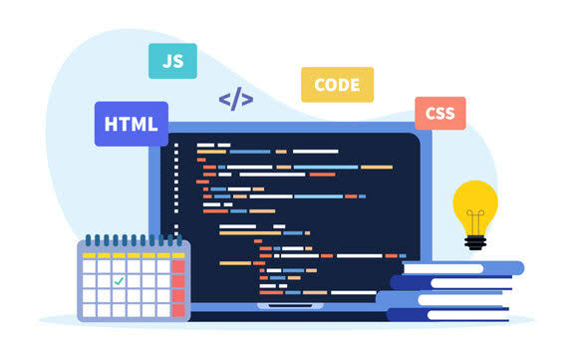
INTRODUCTION
Introduce the field of web development and its importance in creating user-centered applications. Highlight the value of starting with simple projects that build foundational skills. Mention how each project (landing page, portfolio, and calculator) covers different aspects of web development:
Landing Page: Focuses on layout design, color schemes, and alignment.
Portfolio: A complete personal project to showcase skills and experience.
Calculator: Adds interactivity and functionality using JavaScript.

Slide 5
OBJECTIVES
List the primary goals of undertaking these projects:Develop a strong understanding of HTML structure and CSS styling.
Gain confidence in building responsive layouts using CSS.
Implement JavaScript to create interactivity (e.g., calculating operations in the calculator).
Enhance creativity in design and improve problem-solving skills by handling real-world layout challenges.
Build a portfolio that can be used in job applications, demonstrating basic web development skills.

Slide 6
ROLES AND RESPONSIBILITIES
Describe the specific tasks and responsibilities for each project:Landing Page:
Design the structure using HTML elements (headers, footers, sections).
Apply CSS for aesthetic appeal (color palettes, font choices, spacing, and padding).
Ensure responsive design to provide a user-friendly experience across devices.
Portfolio:
Create different sections (Header, About, Skills, Projects, Resume, Contact) to display personal information and skills.
Insert multimedia (images, resume download link) to make the portfolio more engaging.
Focus on styling with CSS to create an organized, visually appealing layout.
Calculator:
Implement HTML layout for calculator buttons and display.
Use CSS for button alignment and visual style (grid layout for button positioning).
Write JavaScript code to handle user input, perform arithmetic operations, and display results.

Slide 7
TASKS UNDERTAKEN
Detail each project with specific tasks:
Landing Page: Created sections with headers and footers, used columns for layout, applied padding and margin to prevent overlapping, and ensured proper alignment.
Personal Portfolio:
Designed a header with a name/logo and tagline.
Added an "About" section with a profile picture and bio.
Listed skills and showcased projects with titles, descriptions, and images.
Provided a link to download the resume and included contact information.
Ensured a professional and polished look through CSS.
Calculator:
Created buttons for operations (addition, subtraction, multiplication, division).
Added a display screen for showing input and results.
Used JavaScript event listeners to capture button clicks, performed calculations, and displayed results on the screen

Slide 8
SKILLS AND KNOWLEDGE GAINED
Discuss the technical and soft skills acquired:HTML & CSS: Learned to structure pages using HTML tags (div, header, footer, section, etc.) and style them with CSS (color, font, padding, alignment).
Responsive Design: Gained experience in ensuring that layouts adapt to various screen sizes using CSS techniques (grid and flexbox).
JavaScript Fundamentals: Gained familiarity with event listeners, if-else logic, loops, and handling arithmetic operations in JavaScript.
Project Management: Developed an understanding of planning project structure, designing interfaces, and meeting design goals.
Problem-Solving: Improved troubleshooting skills by addressing layout issues, overlapping elements, and alignment challenges.

Slide 9
LEARNING OUTCOMES
Outline the final deliverables and their impact:
Successfully designed and published a landing page with a polished, user-friendly layout.
Developed a personal portfolio to showcase skills and completed projects, which can be shared with potential employers or clients.
Built a fully functional calculator with interactive elements, which reinforces JavaScript and CSS grid concepts.
Gained practical experience that has enhanced both technical abilities and creative thinking.

Slide 10
CONCLUSION
Wrap up by summarizing the benefits of completing these projects:Highlight how each project has contributed to building a solid foundation in web development.
Emphasize the value of hands-on experience in HTML, CSS, and JavaScript, and how these skills are applicable in real-world web development scenarios.
Reflect on the confidence gained in creating user-friendly, visually appealing web interfaces and the readiness to take on more advanced projects.

Slide 11
codsoft
https://github.com/shaveenananth/codsoft.git

Slide 12
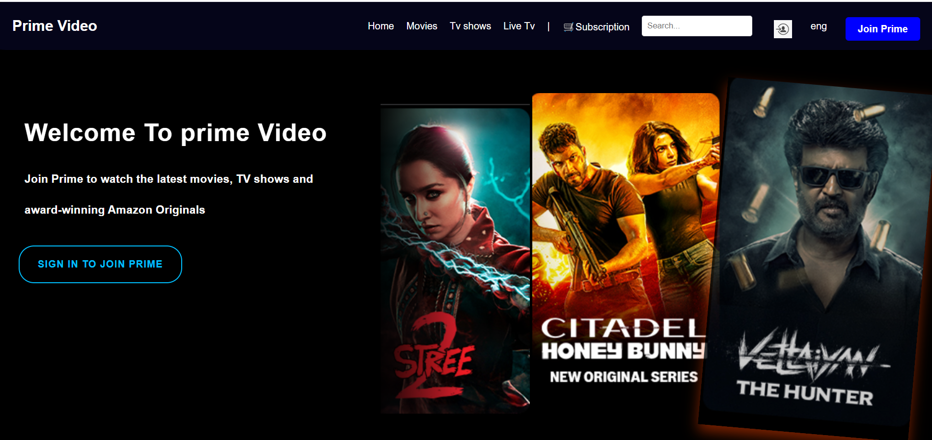
Landing page
https://shaveenananth.github.io/landing-page/

Slide 13
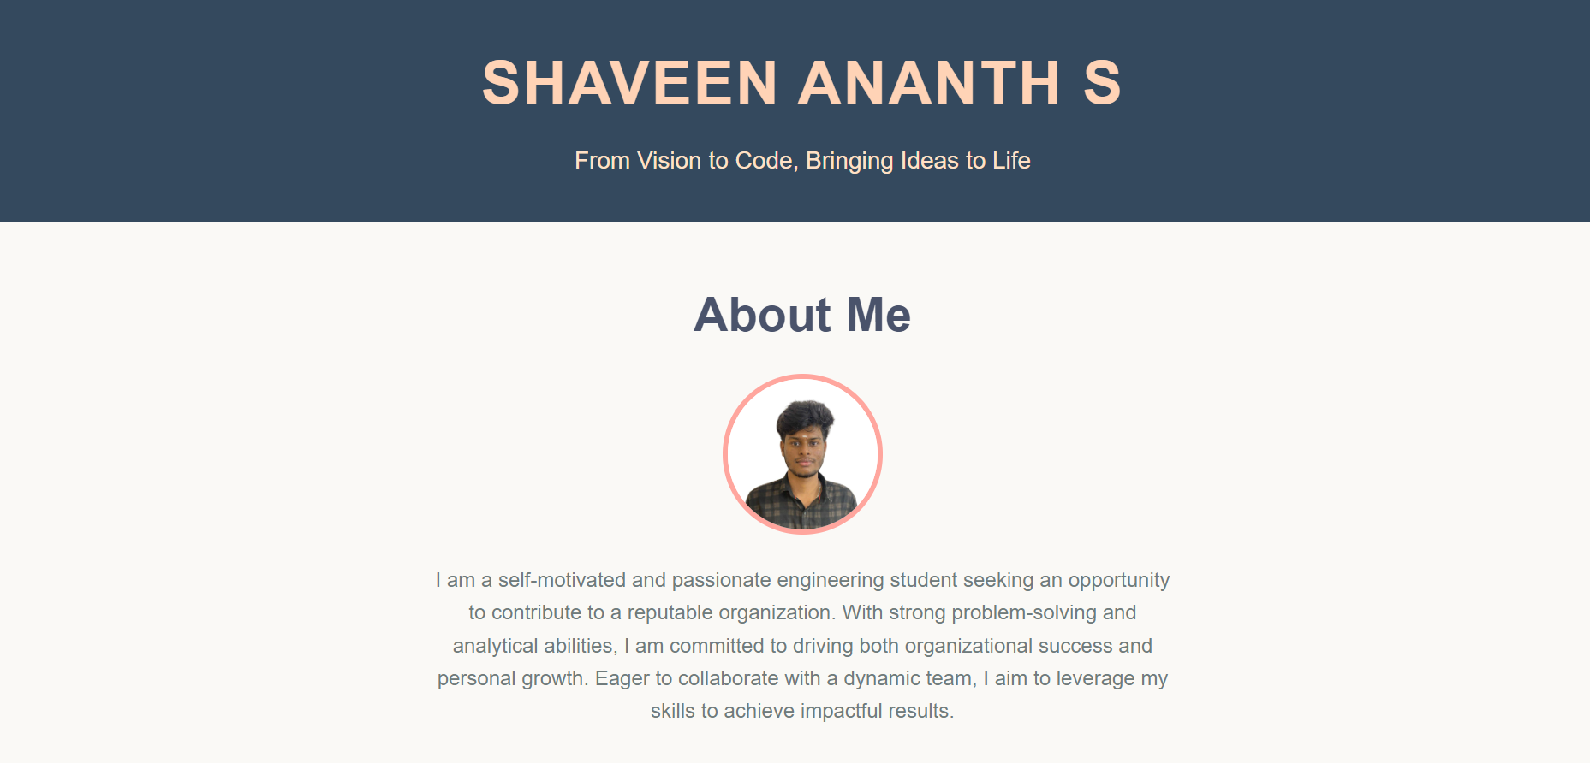
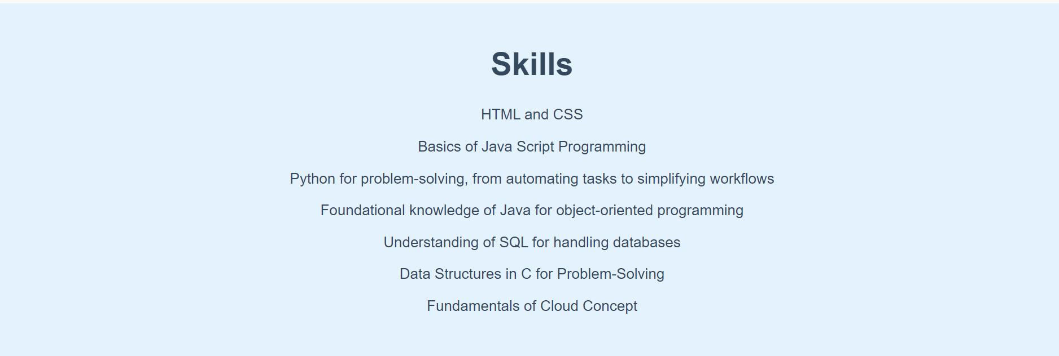
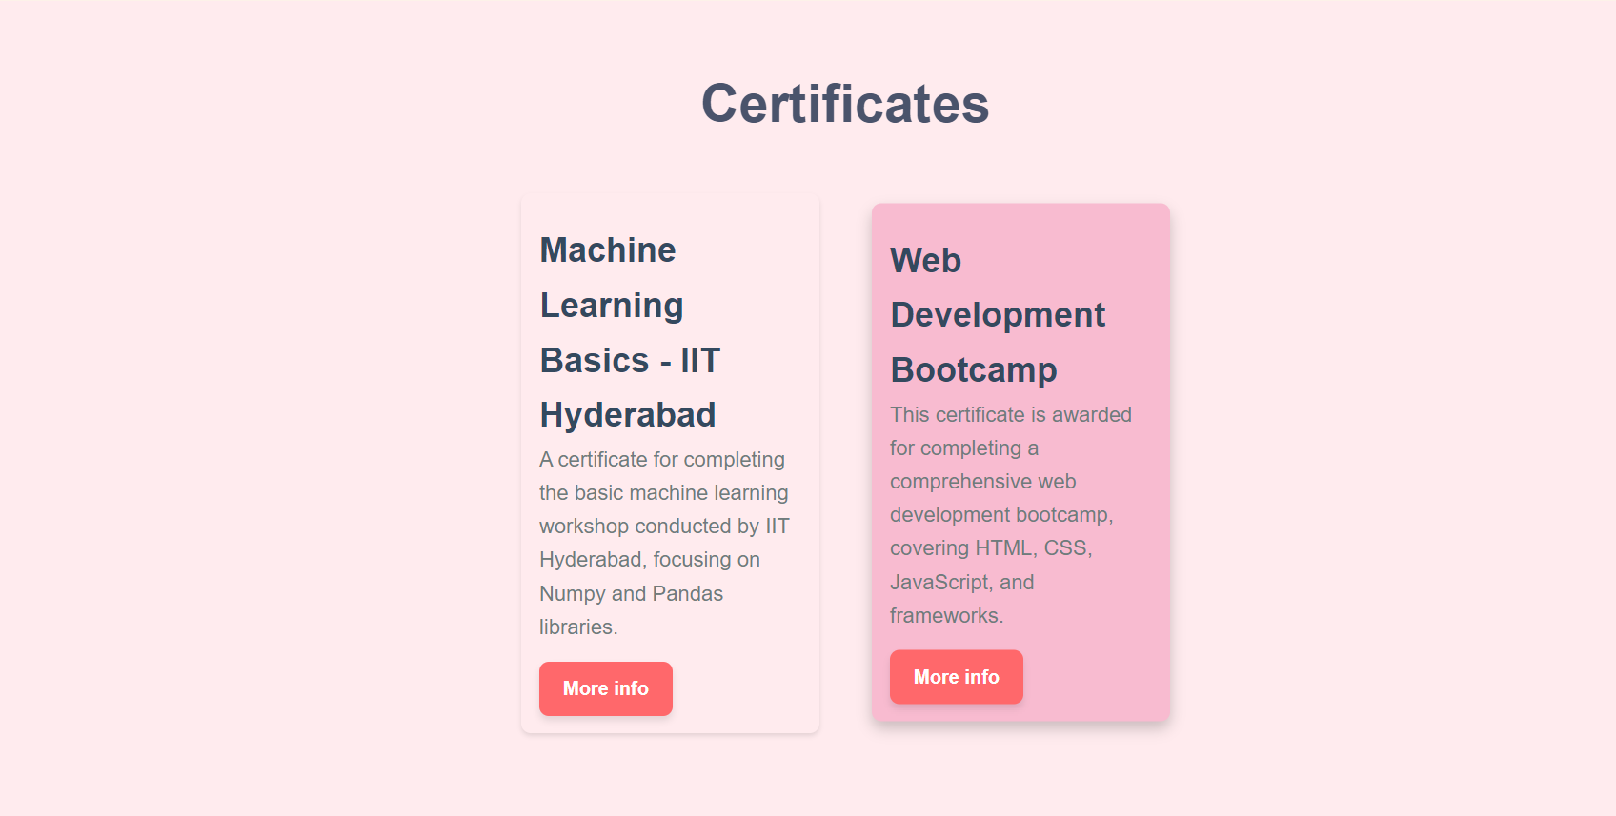
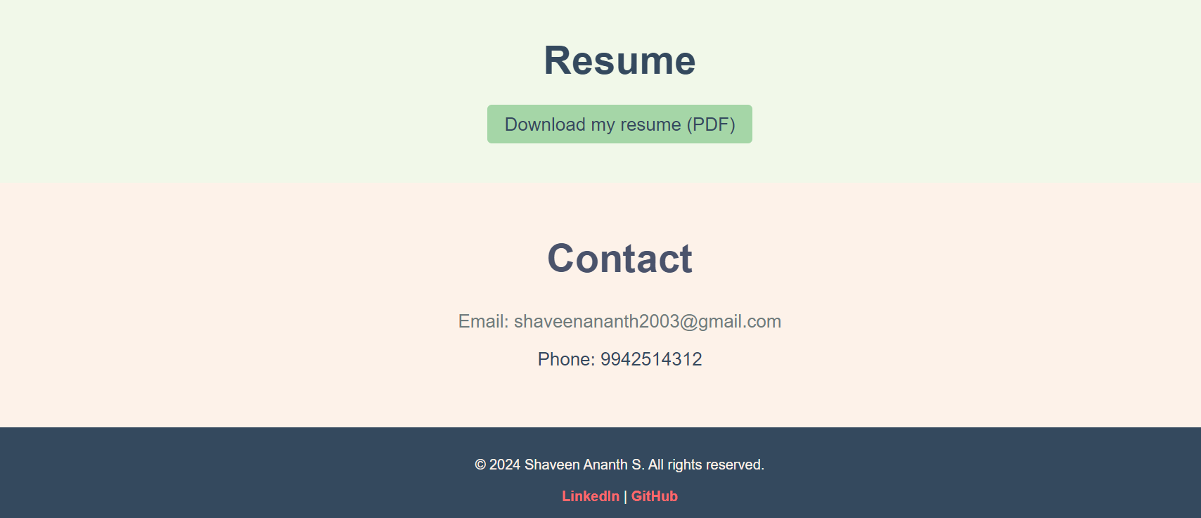
https://shaveenananth.github.io/portfolio/

Slide 14
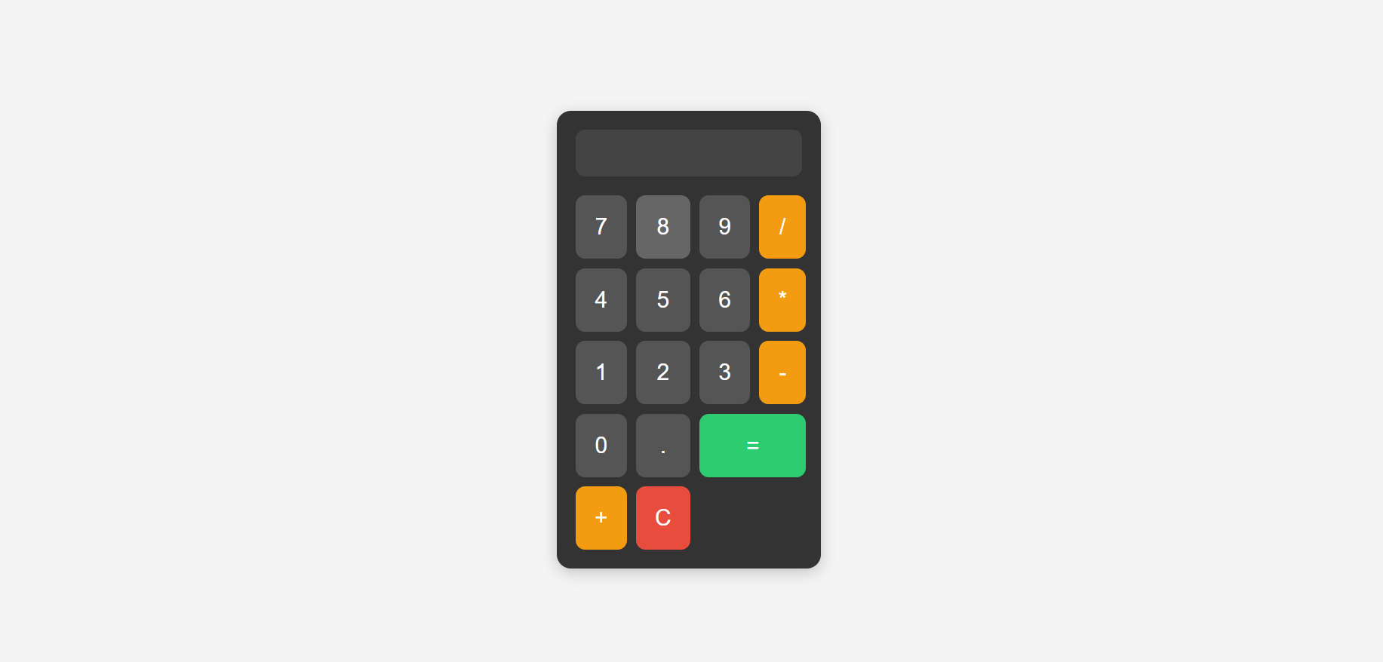
https://shaveenananth.github.io/calculator/

Slide 15
THANK YOU

